Slide 1
FACTORING
AND
FORFAITING

Slide 2
Contents
Section 1
Section 2
Section 3
Factoring
Differences with Invoice discounting
The Factoring Process
Types of Factoring
Functions of a Factor
Advantages and Disadvantages

Slide 3
Why Factoring?
Motivation
Often companies have a pile of account receivables (with varying due dates) waiting to be cashed in and have short term liquidity needs. Accounts receivables represent money owed to the company from its customers for sales made on credit.
Factor Financing or Debtor Financing
Debtor Financing or Factor financing helps these companies improve their short term cash needs by selling account receivables to a third party, typically a financial institution, in return for an immediate injection of cash from the party.

Slide 4
What is Factoring?
Factoring is typically a financial transaction which involves a firm selling its accounts receivables to a third party (known as a factor).
This transfer is generally made at a discount and the firm in turn gets instant cash for financing its ongoing business.
A factor is a financial institution which collects the account receivables from the firm and assumes the credit risk attached with the account (may differ based on different types of factoring).
Essentially factoring transfers the ownership of accounts from the business entity (firm) to another party (factor) that then chases up the debt.

Slide 5
Factoring vs Invoice Discounting
Management and Control
Factoring is a complete transfer of ownership which leads to the factor taking over the management of a firm’s sales ledger and credit control
Adjustments and Advances
In factoring advance or immediate funds are given for the outstanding accounts receivables and adjustments are made on a day to day basis.
In invoice discounting as the sales ledger is managed by the firm itself, larger adjustments (like monthly) are made which may be difficult to deal with.
Risks Assumed
Factoring is less risky compared to invoice discounting as the factor assumes ownership of credit control and collection process.
There is no direct control for the lender in case of invoice discounting.
In invoice discounting the control of sales ledgers and collecting payments from customers is retained by the firm thus making the customers unaware of the drawn agreement between the two parties.

Slide 6
Major Features of Factoring
There are usually three main parties for a factoring process. The client (seller) which initiates the process by selling its account receivables, the customer (buyer) and the factor which is typically a bank or a financial institution.
Generally factoring period ranges between 90 to 150 days and the factor charges a fee for this service i.e. the cost of factoring, which is slightly higher compared to other short term sources of borrowing.
The factor pays a discounted amount at the time of the contract (i.e. part amount ranging between 50% to 80%) and the rest of the payment is done after the collection of money from accounts receivables of the firm.
It is a technique for getting short term liquid needs met without considering the balance sheet. The creditworthiness of the potential buyers may be determined by factoring companies to assess the credit risk involved.

Slide 7
The Factoring Process
1. Client sells some goods to the customer and generates an invoice to the customer
2. The client submits the invoice to get funding from the factor. The invoice sent is verified by the factor
3. After successful verification, the factor pays a discounted amount (around 80%) to the client firm
4. After some time (factoring period), the customer makes the invoice payment to the factor
5. The factor pays the remaining amount to the client after receiving payment from the customer
6. Service fees charged may be upfront or after the process (depends on type of factoring arrangement)

Slide 8
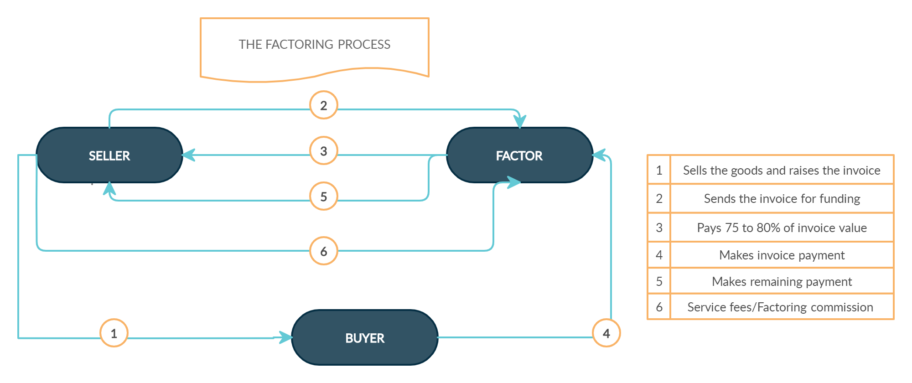
The Factoring Process

Slide 9
Types of Factoring
Recourse Factoring
No protection of bad debts is provided.
Non Recourse Factoring
Denotes absolute responsibility for the factor and it is not entitled to any payments from the client in case of debtors default.
Advance Factoring
Involves payment of a predetermined portion of the debt (75%-90%) in advance at an agreed rate of interest.
If the payment is not made by the customer (or buyer) or default is incurred, then the client is responsible for any loss incurred by the factor.
This is generally more expensive than recourse factoring as it provides protection to clients from bad debts.
The client is responsible for making interest payments and the interest rate is determined on duration, credit standing of client etc.

Slide 10
Types of Factoring
Bank Participation Factoring
A type of advance factoring.
Collection Factoring
No pre-payment is made to the client.
Undisclosed Factoring
In notified factoring the debtor is notified of the agreement and is advised to direct their payments to factor and not the firm.
This involves the bank offering an advance to the client to finance a portion of the factor reserve i.e. factor debt and the advance provided by the factor.
The client receives payment at the guaranteed payment date or on the date of collection (whichever comes earlier).
In undisclosed factoring, no such information is intimated to the debtors. However they are asked to send their payments to a new address.

Slide 11
Types of Factoring
Full Factoring
Also known as without recourse factoring and is a mixture of other types of factoring.
Invoice Factoring
This involves only financing the client and no other services making it not so desirable.
Export Factoring
Also called Cross border or International Factoring.
It is the most comprehensive factoring type which offers various services such as debt protection, ledger administration, collection etc.
Generally the seller and the buyer are present in two different countries which involves cooperation from two factors namely Export factor (seller’s country) and the Import factor (buyer’s country).

Slide 12
Functions of a Factor
On transaction of a sales deal, the client generates an invoice which is then sent to the customer with a copy sent to the factor.
The factor typically maintains the clients’ sales ledger using the open-item method under which each receipt is mapped to a specific invoice. The account of the customer clearly reflects any outstanding open invoices on a particular date.
To detect any change in the payment pattern of the customer, a factor also maintains a customer-wide record of payment proceeds spread over a period of time.
In addition to this the factor gives periodic updates to the client on status of receivables, payments received and other useful information.
Sales Ledger Management
Advisory Services
Short Term Funding
Credit Control and Protection
Collection Facility

Slide 13
Functions of a Factor
Collection Facility
Sales Ledger Mngmt.
Advisory Services
Short Term Funding
Credit Control and Protection
It is the most important feature of the factor. Firstly, the receivables of the client are the only productive assets of the factor besides cost of factoring, thus, an improper collection program may affect the profitability of the factor’s operations.
Secondly, incorrect handling of collections may affect the relationship between client and the customer, which can have a potential loss on a client’s business and the factor’s commission.
Generally a factor is not required to consult the client for the collection procedure, but it may consult the client if any legal action is to be initiated on account of bad debt, refusal of payment etc.

Slide 14
Functions of a Factor
Credit Control and Protection
Collection Facility
Sales Ledger Management
Advisory Services
Short Term Funding
In case of non-recourse type of factoring, the factor assumes the credit risk for the client. As the management is completely handled by the factor, it becomes difficult to properly monitor the credit.
To overcome this, the factor sets a credit line or limit for each customer depending on the credit standing of the customer. The creditworthiness of a customer is determined by:
Credit ratings
Bank reports/Trade references
Financial Statements
Prior collection experience
Customer visits

Slide 15
Functions of a Factor
Short Term Funding
Credit Control and Protection
Collection Facility
Sales Ledger Mngmt.
Advisory Services
A factor usually purchases the book debts of its clients by granting an advance of up to 80-85% and charges an interest on this part payment made till the guaranteed payment date/collection date. The balance 15-20% is retained as factor reserve.
In case of recourse type, the funds provided to the client may be refundable.
Generally, the factor steers clear of funding recourse receivables as it does not take part in credit granting decisions. It may do so with a clear understanding with the client that no advance will be made on such receivables.

Slide 16
Functions of a Factor
Advisory Services
Short Term Funding
Credit Control and Protection
Collection Facility
Sales Ledger Management
Due to their specialized knowledge and experience in the market where the client operates, a factor can provide multiple advisory services to the client such as:
Customer’s perception of the client’s products, marketing strategies, emerging trends etc.
Audits for invoicing, sales returns and delivery procedures
Introduction to the credit department of bank/subsidiaries of banks engaged in leasing, hire-purchasing, merchant banking etc.

Slide 17
Costs of Factoring
Finance Charge: This is the interest charged on the funds made available to the client by way of pre-payment against purchase of approved invoices.
Service Charge: A nominal charge levied at monthly intervals to cover the cost of non-funding services such as collection, sales ledger administration and other advisory services.

Slide 18

Advantages of Factoring
Client (Seller)
Customer (Buyer)
Short term liquidity
Able to provide better credit terms to customers to generate higher revenue
Saves time and resources for maintaining accounts
Smooth functioning and management of the working capital cycle
Assessing quality of debtors and business expansion in new markets
Better and adequate credit facilities
No affect on quality of goods, contractual obligations etc.
Acknowledgment of notification letter for payments is required and no need to furnish any other documentation

Slide 19
Disadvantages of Factoring
Cost of factoring is somewhat high in lieu of fees and other charges
Various terms imposed by factor may lead to stress in the client and customer relationships
The client requires to show all details of customers and sales to the factor
Due to the legal aspects of the factoring arrangement, it may be difficult to change a factor
Sometimes its possible that a client may develop excessive dependence on services provided by the factor

Slide 20
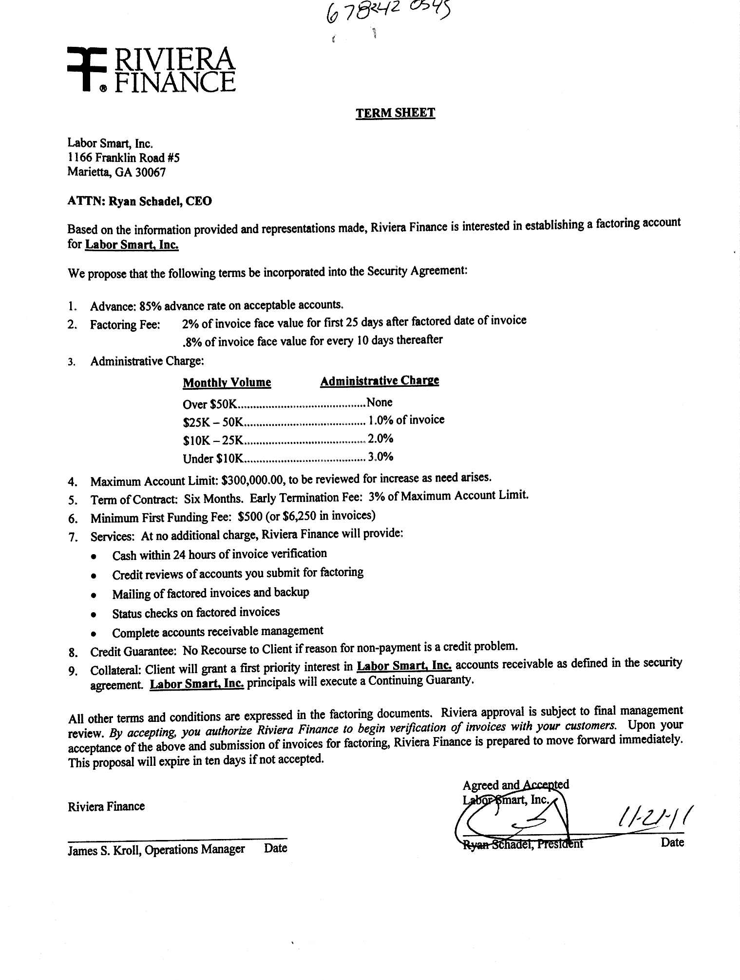
Example of a Factoring Agreement

Slide 21
Contents
Section 1
Section 2
Section 3
Forfaiting
Types of Forfaiting
Pricing
A basic forfaiting transaction
Requirements of a forfaiter
Advantages and Disadvantages

Slide 22
Forfaiting
It is a way of financing enables exporters to receive cash immediately by selling medium and long-term receivables at a discount through an intermediary.
Protection against various risks such as credit risk, transfer risk and the risks related to foreign exchange rates or changes in interest rate.
The individual or entity purchasing the receivables is called forfaiter.
The forfaiter then receive payable by the importers.

Slide 23
History of forfaiting
It was developed in Switzerland in the 1950s to fill the gap between the exporter and the importer.
According to industry sources estimates the total annual volume of new forfaiting transactions is around $30 billion and that forfaiting transactions worth $60 to $75 billion is outstanding at any given time.
There are still no official statistics available on the size of the global forfaiting market even after huge growth number of forfaiting transactions worldwide.

Slide 24
Types of Forfaiting
Various types of financial agreement that a forfeiter can purchase and convert to debt instruments are:
Promissory notes - importers issue these and provide a written promise to pay the exporter
Bills of exchange - a written order similar to promissory notes that bind an importer to pay an exporter a fixed sum
Account receivables - show the amount of money owing, and they are listed as yet to be paid on the current balance sheet
Letters of credit - issued by banks which provide guarantee about the payment of debt even if the importer defaults
Competitive Positioning

Slide 25
Pricing
Three elements relate to the pricing of a forfaiting transaction:
Discount rate, the interest element is usually quoted as a margin over LIBOR.
Days of grace, added to the actual number of days until maturity
Commitment fee, applied from the date of committed to until the date of discounting.

Slide 26
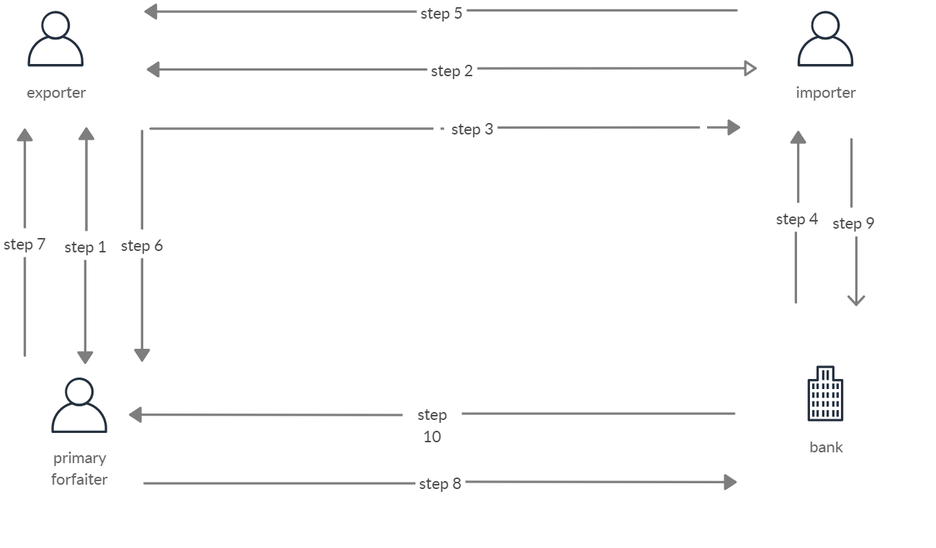
How basic forfaiting transaction takes place?

Slide 27
How basic forfaiting transaction takes place?
Step 1: forfaiting agreement between Forfeiter and Exporter.
Step 2: Signing of contract between Exporter and Importer.
Step 3: Shipment is initiated by the exporter.
Step 4: The importer obtains a guarantee from his bank.
Step 5: importer sends documents to the exporter.

Slide 28
How basic forfaiting transaction takes place?
Step 6: Exporter provides documents to forfeiter.
Step 7: Forfeiter controls the documents pays for them as indicated on the Forfaiting Agreement.
Step 8: Forfeiter presents documents to the bank at the maturity date.
Step 9: payment made by Importer to the bank at the maturity date.
Step 10: Bank pays to forfeiter at the maturity date.

Slide 29
What information does a Forfaiter need?
The Forfaiter needs to know about the buyer his nationality, goods being sold; detail of the value and currency of the contract; and the date and duration of the contract, including the credit period and number and timing of payments (including any interest rate already agreed with the buyer).
the knowledge of debt evidence (either promissory notes, bills of exchange, letters of credit) is important.
the identity of the guarantor of payment.

Slide 30
Documentary Requirements
Invoice: forfaiting discount, commitment fees, etc. does not need to be shown separately instead, these could be built into the FOB price, stated on the invoice.
Shipping Bill and GR form: Details of the forfaiting costs are to be included along with the other details, such as FOB price, commission insurance, normally included in the "Analysis of Export Value "on the shipping bill. The claim for duty drawback, if any is to be certified only with reference to the FOB value of the exports stated on the shipping bill.

Slide 31
Costs of Forfaiting
the level of interest rates relevant to the currency of the underlying contract at the time of the Forfaite Commitment.
the credit risks related to the importing country and to the availing (or guaranteeing) bank

Slide 32

Advantages and Disadvantages
Advantages
Disadvantages
forfaiting eliminates the risk of payment of the exporter
forfaiting simplifies the transaction by transforming a credit-based sale into a cash transaction
helpful in a country where a specific bank within the country have no access to an export credit agency (ECA).
helpful to exporter in a country with high levels of political risk.
forfaiting is generally more expensive than commercial lender financing leading to higher export costs.
Transactions over $100,000 with longer terms are eligible for forfaiting, but it is not available for deferred payments.
There is no international credit agency to provide guarantees for forfaiting companies. This lack of guarantee affects long-term forfaiting.

Slide 33
Real-World Example
The Black Sea Trade & Development Bank (BSTDB) lists forfaiting in its list of special products along with underwriting, hedging instruments, financial leasing, and discounting.
The minimum operation size that BSTDB will finance through forfaiting is euro 5 million with a repayment period of one to five years.
BSTDB was established as a source of financing for development projects by 11 founding countries—Albania, Armenia, Azerbaijan, Bulgaria, Georgia, Greece, Moldova, Romania, Russia, Turkey, and Ukraine.
The bank may also apply option, commitment, termination, or discount rate fees.

Slide 34
Contents
Section 1
Section 2
Section 3
Factoring v/s Forfaiting
Factoring in India
Global Factoring Scenario
Growth of Factoring in India
Forfaiting in India

Slide 35
Differences between Factoring and Forfaiting
Basis of differences | Factoring | Forfaiting
Extent of financing | Usually 80% | 100%
Credit worthiness | Factor does the credit rating | Forfaiting agency relies on credibility of the availing bank
Services provided | Factors provide some day-to-day administration of sales and other allied services. | No services are provided.

Slide 36
Factoring in India
SBI Factors and Commercials Limited was the first factoring company to start its operation in India in April 1991. Since then a number of companies have started factoring business in India.
The business of factoring in India is regulated by the Factoring Regulation Act, 2011. At present, the factoring business can be carried out by either banks or NBFCs(Nonbank financial companies).

Slide 37
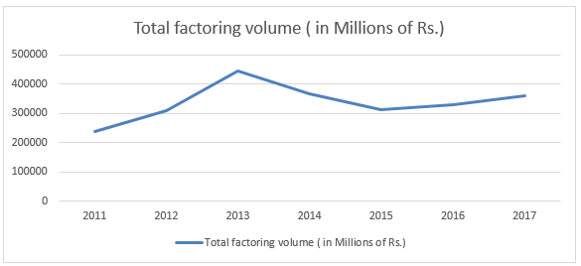
Factoring scenario in India
Since its inception, factoring business has made significant progress in India.

Slide 38
Factoring companies in India
SBI Global. (Website)
Canbank Factors Limited. (Website)
The Hongkong and Shanghai Banking Corporation Ltd. (Website)
IFCI Factors Limited (Website)
Siemens Factoring Private Limited (Website)
Export Credit Guarantee Corporation of India Ltd. (Website)
Citibank NA, India (Website)
Standard Chartered Bank (Website)
YES BANK Limited (Website)
India Factoring and Finance Solutions Pvt Ltd (Website)
DBS (Website)
[Some more companies here.]

Slide 39
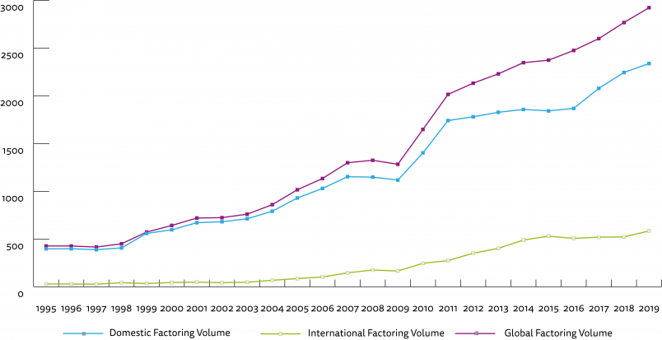
Global scenario
Factoring business is becoming popular over the world on account of various services offered by the factors. The world factoring statistics indicate that the factoring industry volume has shown significant growth. (source: fci.nl )

Slide 40
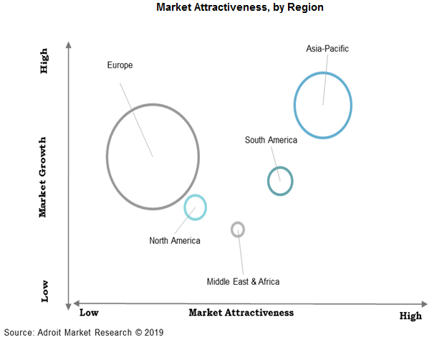
Global scenario
Europe has the highest market growth and there is a low scope for investments. The Asia Pacific has the highest growth rate and high market investment opportunities as most of the economies are developing.
Notes:
The above graph represents the market growth on Y-axis and market attractiveness on X-axis by region. Europe has the highest market growth and there is a low scope for investments. North America has the growth and the market is highly penetrated. The Asia Pacific has the highest growth rate and high market investment opportunities as most of the economies are developing.

Slide 41
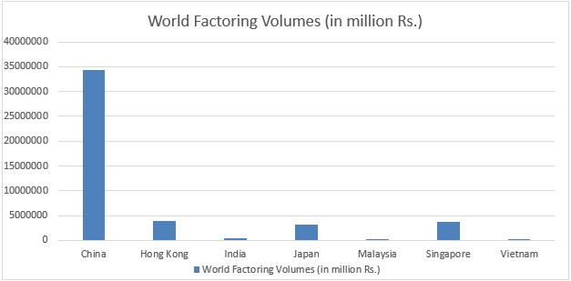
Global scenario
The graph corresponds to the year 2017, and it shows that India’s contribution to the factoring market is very less.

Slide 42
What hinders the growth of factoring services in India?
Wrong Market segmentation: Factoring is globally aimed at smaller businesses who are looked at as ‘high risk’ by traditional banks or who do not possess security/collateral to avail funding from bankers. However, in India, the product was and is aimed at mid-sized businesses that are mostly well banked. As a result, the product is looked at as an alternative ‘loan, rather than the service which it actually is. However, if the target had been micro & small (MSE) customers, the product appreciation and development would have been better

Slide 43
What hinders the growth of factoring services in India?
Excessive Transactional Documentation: As part of receivables discounting process, factors need documents to evidence legal sale. With some mandatory documents like invoices, evidence of shipment and often a purchase order, Factors in India as an attempt to reduce the transactional risk, started asking for some more cumbersome documents. These were typically, proof of good receipt, acceptance of goods in writing, quality and test reports, signature verifications of stores in charge, insurance copies etc. Thus , Factoring began to be perceived as a complex product and lost out when compared to simpler and cheaper bank options like an overdraft limit
Notes:
Thus, a useful service for providing liquidity to MSMEs got reduced to a complex loan option with high risks for factors leading to a stunted growth and eventually becoming a marginal offering.

Slide 44
Forfaiting in India
For a long time, Forfaiting was unavailable in India. Recognizing the utility of Forfaiting services to Indian exporters, the RBI decided to make available such services to the exporters. With the setting up of export-import banks, since 1994 forfaiting is available
Exim Bank, established by an act of parliament in 1982, is India's premier export finance institution. The bank facilitates, promotes and finances exports from India responding to exporters needs on a continuous and proactive basis. It was the first to introduce forfaiting into India in 1992.

Slide 45
Forfaiting in India
The role of the EXIM Bank has been that of a facilitator between the Indian exporter and the overseas Forfaiting agency. Scheduled commercial banks have also been permitted to offer Forfaiting services by acting as an agent or a facilitator between Indian exporter and the. Forfaiting agency operating in some other country.
A subsidiary of EXIM bank, namely Global Trade Financial Services Private Ltd.(GTF) has been engaged in providing Forfaiting services to the exporters in India.

Slide 46
Forfaiting in India
The exim bank undertakes forfaiting for a minimum value of Rs. 5 lakhs. For this purpose, the exporter has to execute a special Pronote in favor of the exim bank. The exporter will first enter into an agreement with the importer as per the quotation given to him by the exim bank. The exim bank on its part, gets quotation from the forfaiting agency abroad. Thus, the entire forfaiting process is completed by exporter agreeing to the terms of the exim bank and signing the Pronote.
Forfaiting business in India will pick up only when there is trading of foreign bills in international currencies in India for which the value of domestic currency has to be strengthened. This would be possible only with increasing exports. At present, India’s share stands at 1.7 percent in the world exports. Perhaps, this will bring a push to the forfaiting market.
Notes:
In view of this, the exporter, who intends to avail Forfaiting facility, should finalise the export contract in a manner which ensures that the amount received in foreign exchange by him after payment of Forfaiting discount and other fees is equivalent to the price which he would obtain if goods were sold on cash payment terns.

Slide 47
Sources
https://www.businessexpert.co.uk/invoice-finance/invoice-discounting-or-factoring/#:~:text=With%20factoring%20you%20are%20given,not%20manage%20your%20sales%20ledger
https://www.letslearnfinance.com/factoring-features.html
https://efinancemanagement.com/sources-of-finance/factoring
https://static1.squarespace.com/static/537e8bcbe4b09ac6c31f0ae6/t/53db0556e4b0ea7cdef49084/1406862678189/TF_Factoring+and+Forfaiting+ICFAI.pdf
https://accountlearning.com/forfaiting-meaning-parties-involved-merits-demerits-forfaiting-in-india/
https://globaltradefunding.com/trade-finance-solutions/export-financing/export-forfaiting/
https://www.crfonline.org/orc/pdf/Forfaiting.pdf
https://www.letterofcredit.biz/index.php/2018/12/03/how-forfaiting-works/
https://www.iwoca.co.uk/finance-explained/forfaiting/
https://www.adroitmarketresearch.com/industry-reports/factoring-market
https://www.howtoexcel.info/New/factoring_india/
https://www.business.com/categories/best-factoring-companies/
https://in.kompass.com/a/factoring/82340/
http://www.eximguide.in/Ch-7-Forfeiting-Factoring.aspx
https://howtoexportimport.com/Forfeiting-scheme-of-EXIM-bank-of-India-4612.aspx
https://in.kompass.com/a/forfaiting-banking/8214045/
http://www.egyankosh.ac.in/bitstream/123456789/6452/1/Unit-19.pdf

Slide 48
Thank You
Have any questions? Contact us.
Team Details
Karan Virender Mahajan(17CH3FP05) karanvirendermahajan@gmail.com
Saikat Mondal(17MT3FP04) saikatmondal410@gmail.com
Rishita Raj(19ME10054) rishitars14@gmail.com

